Slide 1
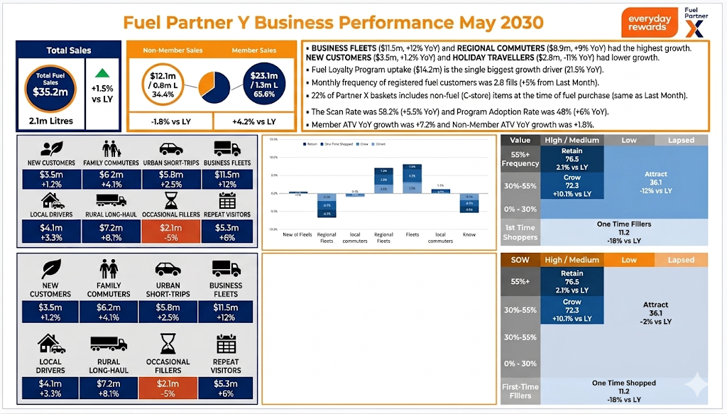
Fuel Partner Y Business Performance Dec 2029

